Slide 1
FOOD FLAVOUR TREND ANALYSIS
Alexandria Low

Slide 2
CONTEXT
I am working for a Company as an analyst and the Company’s products are food stuff eg. Snacks, convenience meals
My scope is to analyze the data and provide findings.
Further work will be carried out by the relevant departments.
Ultimate goal is to answer to our problem statement collectively

Slide 3
PROBLEM STATEMENT
Identifying opportunities for growth. Such as Increasing market share. Opportunity can be evidenced by:
As per external market research, the spices and savoury segment is registering immense growth within the food flavours market. This trend is largely driven by consumers' growing interest in multicultural cuisines and adventurous eating experiences.(Fortune Business Insights, https://www.fortunebusinessinsights.com/food-flavors-market-102745).
The Asia Pacific Food Flavours Market Size is expected to have a steady increase up till 2028. Currently the market size stands at more than USD 5m.
(6WResearch, https://www.6wresearch.com/industry-report/malaysia-food-flavors-market).
'Increasing application of food flavours across the packaged food industry... will accelerate market growth...’
'Various multinational giants are mainly focusing on the development of exotic and unique delicious food flavours, to attract a large number of consumers towards food flavours. Strong demand for convenient food products will create growth opportunities for food flavouring industry.’
(GMI Research, https://www.gmiresearch.com/report/food-flavors-market/).

Slide 4
OBJECTIVE
Analyse food flavour trends for product development and innovation for market share growth whilst maintaining competitiveness in a growing and fast moving industry (Capitalize on the growth opportunity)

Slide 5
THE NEED FOR PRODUCT DEVELOPMENT AND INNOVATION
Driving Growth: Market share, New customers, Key drivers to revenue growth, new market opportunities, expand customer base
Brand Enhancement. Innovation and creativity .
Competitive Environment: In today's competitive marketplace, companies need to differentiate themselves from competitors. Innovative products that offer unique features, flavours, or benefits can provide a competitive edge and attract customers away from rival brands.
Meeting Consumer Demand: Consumer preferences and tastes are constantly changing
Adapting to Market Trends: Adaptability to trends and innovate accordingly can better positioned to capitalize on emerging opportunities
Switching cost of customer: Rather low
OPPORTUNITIES
THREATS

Slide 6
STAKEHOLDERS
Executive Leadership: CEO, CFO, Top-level Executives
Product Development Team
Marketing Department
Sales Team
Research and Development (R&D) Team
Supply Chain and Procurement Team
Food Quality and Food Safety Team

Slide 7




ANALYSIS OF RECIPE DATASET
RATING
Yummy
FLAVOURS
Satisfaction & Popularity
AROMA
CULTURE
Cooking combinations of ingredients
Cuisine influences
INGREDIENTS
The foundation of flavour lies in the ingredients themselves
Every component brings its unique taste profile

Slide 8
ANALYSIS OF RECIPE DATASET What we are working with:
PROCESSED RECIPE DATASET TO FOCUS ON THESE 3 FACTORS
Satisfaction & Popularity
RATING
INGREDIENTS
CUISINE
Highest average rating
Highest frequency of ingredient type
Highest frequency of cuisine type

Slide 9
ANALYSIS OF RECIPE DATASET Findings: Information gathered
Cluster 1 Most popular ingredients
No. | Ingredients | Frequency
1 | 'thai', 'noodle', 'vegetable', 'oil', 'minced', 'garlic', 'sweet', 'paprika', 'fish', 'sauce', 'white', 'vinegar', 'sugar', 'oil', 'leek', 'tofu', 'egg', 'scallion', 'beansprouts', 'peanut', 'lime' | 237
2 | 'red', 'bell', 'pepper', 'olive', 'oil', 'mushroom', 'ginger', 'garlic', 'lemon', 'grass', 'sambal', 'ulek', 'chicken', 'broth', 'coconut', 'milk', 'sugar', 'soy', 'sauce' | 199
3 | ''chicken', 'liver', 'dark', 'soy', 'sauce', 'mirin', 'sake', 'brown', 'sugar', 'garlic', 'clove', 'fresh', 'ginger', 'scallion' | 197
4 | 'fresh', 'corn', 'pepper', 'butter', 'salt' | 191
5 | 'sushi', 'rice', 'avocado', 'crabmeat', 'seed', 'nori', 'toasted', 'sesame', 'seed', 'wasabi', 'soy', 'sauce' | 182
6 | 'water', 'white', 'sugar', 'grated', 'lemon', 'zest', 'lemon', 'juice', 'strawberry', 'carbonated', 'water', 'ice', 'mint' | 175
7 | 'olive', 'oil', 'egg', 'rice', 'dark', 'sesame', 'oil', 'fresh', 'spinach', 'leaf', 'avocado', 'toasted', 'sesame', 'seed' | 159
8 | 'chicken', 'breast', 'kielbasa', 'diced', 'tomato', 'onion', 'celery', 'green', 'bell', 'pepper', 'garlic', 'cajun', 'seasoning', 'cayenne', 'pepper', 'broth', 'dried', 'oregano', 'dried', 'parsley', 'dried', 'thyme', 'cooked', 'rice' | 157
9 | 'red', 'bliss', 'potato', 'olive', 'oil', 'sea', 'salt', 'freshly', 'ground', 'pepper', 'fresh', 'rosemary' | 153
10 | 'water', 'sugar', 'lime', 'rind', 'fresh', 'lime', 'juice', 'ice', 'water' | 143
Cluster 1 Most popular cuisine
No. | Cuisine | Frequency
1 | American | 222
2 | French | 88
3 | Italian | 80
4 | Cajun | 77
5 | Greek | 74
6 | Asian | 74
7 | German | 72
8 | Irish | 61
9 | Cuban | 47
10 | Chinese | 35
Table 2. Popular cuisines Cluster 1
Table 1. Popular ingredients Cluster 1

Slide 10
ANALYSIS OF RECIPE DATASET Findings: Information gathered
Cluster 2 Most popular ingredients
No. | Ingredients | Frequency
1 | 'thai', 'noodle', 'vegetable', 'oil', 'minced', 'garlic', 'sweet', 'paprika', 'fish', 'sauce', 'white', 'vinegar', 'sugar', 'oil', 'leek', 'tofu', 'egg', 'scallion', 'beansprouts', 'peanut', 'lime' | 71
2 | 'red', 'bell', 'pepper', 'olive', 'oil', 'mushroom', 'ginger', 'garlic', 'lemon', 'grass', 'sambal', 'ulek', 'chicken', 'broth', 'coconut', 'milk', 'sugar', 'soy', 'sauce' | 64
3 | 'chicken', 'liver', 'dark', 'soy', 'sauce', 'mirin', 'sake', 'brown', 'sugar', 'garlic', 'clove', 'fresh', 'ginger', 'scallion' | 60
4 | 'sushi', 'rice', 'avocado', 'crabmeat', 'seed', 'nori', 'toasted', 'sesame', 'seed', 'wasabi', 'soy', 'sauce' | 54
5 | 'olive', 'oil', 'egg', 'rice', 'dark', 'sesame', 'oil', 'fresh', 'spinach', 'leaf', 'avocado', 'toasted', 'sesame', 'seed' | 53
6 | 'water', 'white', 'sugar', 'grated', 'lemon', 'zest', 'lemon', 'juice', 'strawberry', 'carbonated', 'water', 'ice', 'mint' | 51
7 | 'fresh', 'corn', 'pepper', 'butter', 'salt' | 49
8 | 'red', 'bliss', 'potato', 'olive', 'oil', 'sea', 'salt', 'freshly', 'ground', 'pepper', 'fresh', 'rosemary' | 46
9 | 'water', 'sugar', 'lime', 'rind', 'fresh', 'lime', 'juice', 'ice', 'water' | 45
10 | 'chicken', 'breast', 'kielbasa', 'diced', 'tomato', 'onion', 'celery', 'green', 'bell', 'pepper', 'garlic', 'cajun', 'seasoning', 'cayenne', 'pepper', 'broth', 'dried', 'oregano', 'dried', 'parsley', 'dried', 'thyme', 'cooked', 'rice' | 41
Cluster 2 Most popular cuisine
No. | Cuisine | Frequency
1 | Hungarian | 140
2 | Asian | 115
3 | Cajun | 90
4 | Indian | 84
5 | Greek | 83
6 | Italian | 71
7 | French | 65
8 | Chinese | 58
9 | American | 55
10 | Cuban | 54
Table 4. Popular cuisines Cluster 2
Table 3. Popular ingredients Cluster 2

Slide 11
ANALYSIS OF RECIPE DATASET Findings: Information gathered
Cluster 3 Most popular ingredients
No. | Ingredients | Frequency
1 | chicken', 'liver', 'dark', 'soy', 'sauce', 'mirin', 'sake', 'brown', 'sugar', 'garlic', 'clove', 'fresh', 'ginger', 'scallion' | 63
2 | 'chicken', 'breast', 'kielbasa', 'diced', 'tomato', 'onion', 'celery', 'green', 'bell', 'pepper', 'garlic', 'cajun', 'seasoning', 'cayenne', 'pepper', 'broth', 'dried', 'oregano', 'dried', 'parsley', 'dried', 'thyme', 'cooked', 'rice' | 62
3 | 'thai', 'noodle', 'vegetable', 'oil', 'minced', 'garlic', 'sweet', 'paprika', 'fish', 'sauce', 'white', 'vinegar', 'sugar', 'oil', 'leek', 'tofu', 'egg', 'scallion', 'beansprouts', 'peanut', 'lime' | 59
4 | 'red', 'bell', 'pepper', 'olive', 'oil', 'mushroom', 'ginger', 'garlic', 'lemon', 'grass', 'sambal', 'ulek', 'chicken', 'broth', 'coconut', 'milk', 'sugar', 'soy', 'sauce' | 52
5 | 'extra-virgin', 'olive', 'oil', 'sweet', 'onion', 'balsamic', 'vinegar', 'chicken', 'breast', 'garlic', 'salt', 'pepper', 'chicken', 'broth', 'honey' | 51
6 | 'olive', 'oil', 'egg', 'rice', 'dark', 'sesame', 'oil', 'fresh', 'spinach', 'leaf', 'avocado', 'toasted', 'sesame', 'seed' | 47
7 | 'water', 'sugar', 'fresh', 'ginger', 'fresh', 'lime', 'juice', 'ginger', 'ale' | 45
8 | 'red', 'bliss', 'potato', 'olive', 'oil', 'sea', 'salt', 'freshly', 'ground', 'pepper', 'fresh', 'rosemary' | 43
9 | 'vegetable', 'oil', 'boneless', 'skinless', 'chicken', 'breast', 'andouille', 'sausage', 'shrimp', 'creole', 'seasoning', 'dri', 'leav', 'thyme', 'cayenne', 'pepper', 'onion', 'garlic', 'green', 'bell', 'pepper', 'celery', 'long', 'grain', 'white', 'rice', 'canned', 'chopped', 'tomato', 'chicken', 'stock', 'fresh', 'parsley' | 41
10 | 'filet', 'mignon', 'black', 'truffle', 'oil', 'salt', 'freshly', 'ground', 'pepper', 'smoked', 'bacon' | 41
Cluster 3 Most popular cuisine
No. | Cuisine | Frequency
1 | American | 222
2 | French | 88
3 | Italian | 80
4 | Cajun | 77
5 | Greek | 74
6 | Asian | 74
7 | German | 72
8 | Irish | 61
9 | Cuban | 47
10 | Chinese | 35
Table 6. Popular cuisines Cluster 3
Table 5. Popular ingredients Cluster 3

Slide 12



FINDINGS
THE MOST POPULAR INGREDIENTS
THE MOST POPULAR CUISINES
ENDLESS FLAVOUR POSIBILITIES

Slide 13

WHAT’S NEXT?
Our findings will be summarized and disseminated to the relevant department heads for further action. Eg.
Product Development Dept :
Start R&D with these ingredients and cuisine influences identified to create new flavoured products
Supply Chain Procurement Dept:
To assess the availability and obtainability of the ingredients
MAKE THE MAGIC HAPPEN

Slide 14
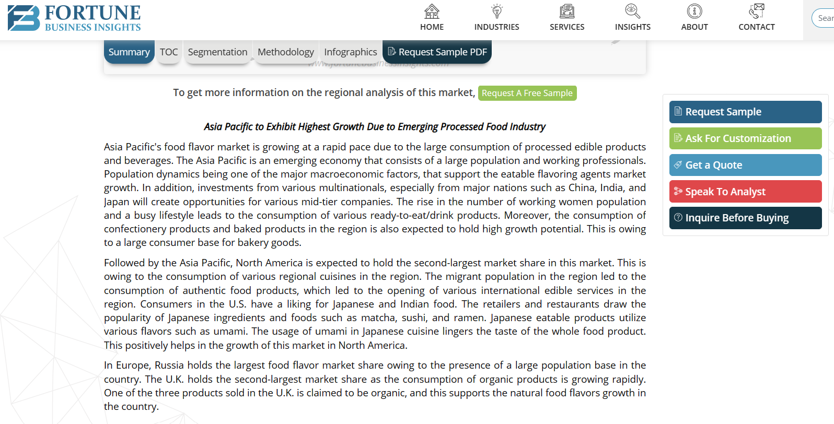
Reference
Food Flavors Market Size, Global Share, Forecast, 2032 (fortunebusinessinsights.com)

Slide 15
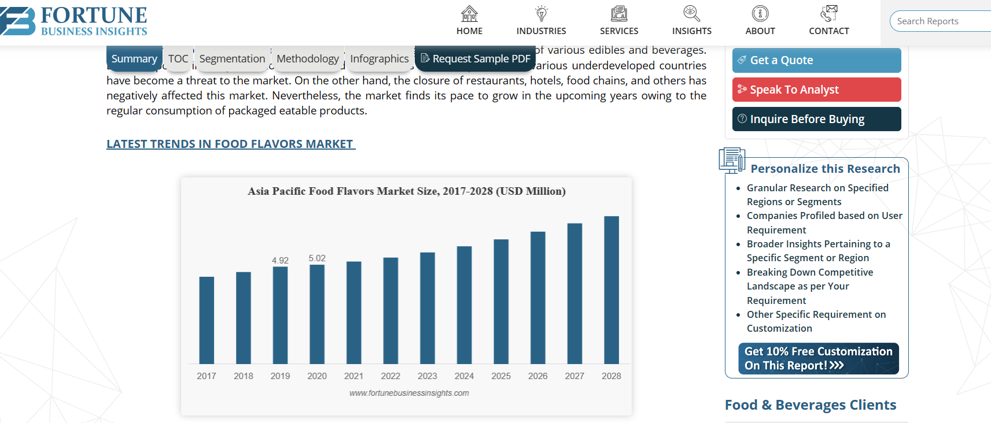
Reference
Food Flavors Market Size, Global Share, Forecast, 2032 (fortunebusinessinsights.com)

Slide 16

Reference
Malaysia Food Flavors Market | Grow at 4.12% CAGR till 2030 (6wresearch.com)

Slide 17
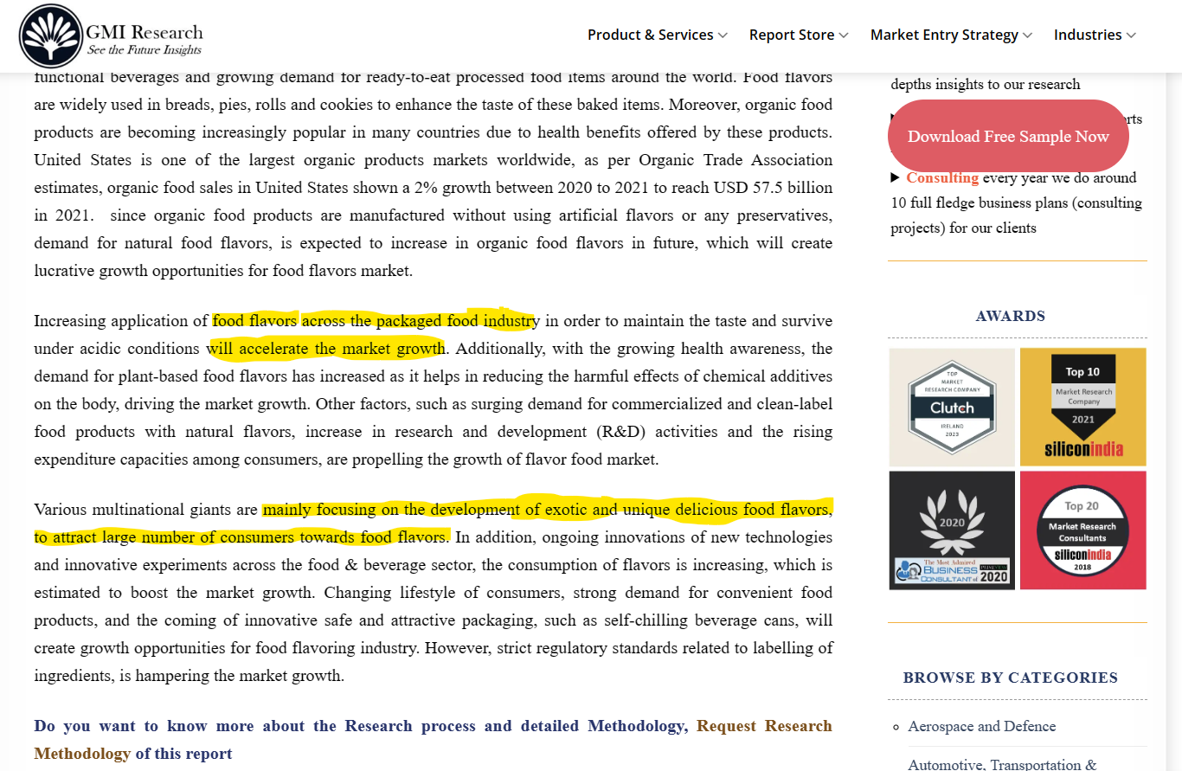
Reference
Food Flavors Market Size, Share, Trends & Analysis Report 2030 (gmiresearch.com)

Slide 18
Appendix

Slide 19
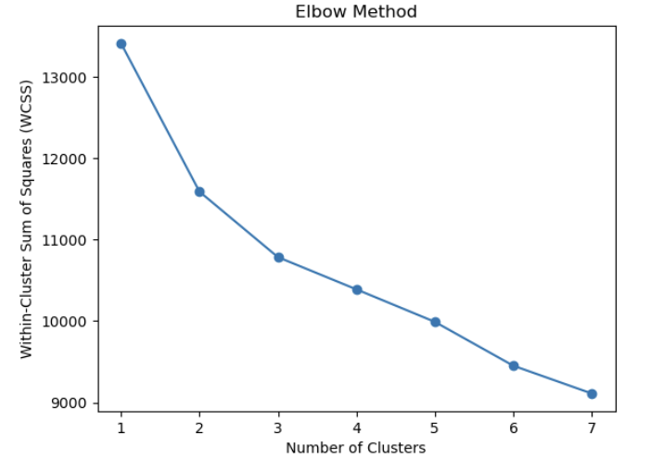
APPENDIX ANALYSIS OF RECIPE DATASET
Optimal number of clusters is 3
Appendix 1. Elbow method

Slide 20
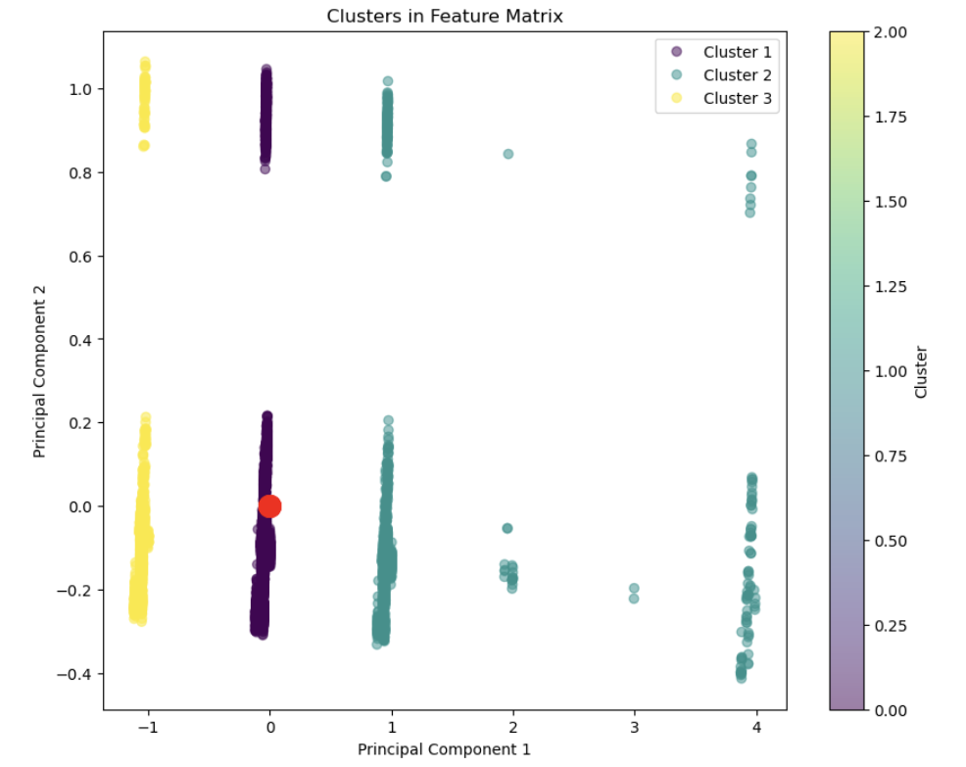
APPENDIX ANALYSIS OF RECIPE DATASET
PC1:
Captures it is the direction along which there is the greatest variance in the data, the most significant pattern in the dataset, accounting for the largest part of the data’s total variation.
PC2:
Captures the next level of variation that was not captured by PC1.
Appendix 2. Cluster plot

Slide 21
Thank you

